Slide 1
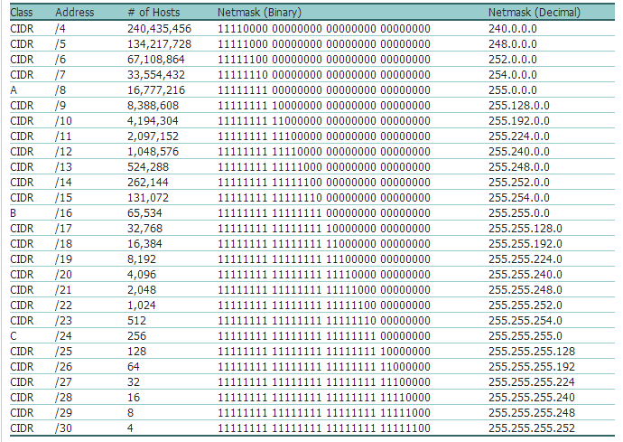

Slide 2
Example 18.4
An ISP has requested a block of 1000 addresses. Since 1000 is not a power of 2, 1024 addresses are granted. The prefix length is calculated as n = 32 − log₂1024 = 22. An available block, 18.14.12.0/22, is granted to the ISP. It can be seen that the first address in decimal is 302,910,464, which is divisible by 1024.
18.2

Slide 3
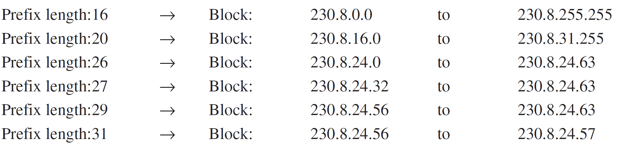
Example 18.3
In classless addressing, an address cannot define the block the address belongs to. For example, the address 230.8.24.56 can belong to many blocks. Some of them are shown below with the value of the prefix associated with that block.
16, 20, 26, 27, 29, 31
18.3

Slide 4
3 levels of hierarchy - Subnetting
Large Block of Address
Clusters of Networks (Subnet)
Divide the address between subnets
Rest of world will see as one-entity
Router connects organization to rest of world
Router routes to appropriate subnets
Organization – Own mask, each subnet – subnet-mask

Slide 5
Designing Subnets
Sub-networks design
Total no of address granted to organization is N
Prefix length of each sub-network n_{sub}
Assigned no of address to each sub-network is N_{sub}
No of address in each sub network should be power of 2
Prefix length of each subnetwork n_{sub =} 32 - log₂N_{sub}
Starting Address in each subnetwork divisible by Number of address in that subnetwork
(First Assign Address to larger subnetworks)

Slide 6
Example 18.5
An organization is granted a block of addresses with the beginning address 14.24.74.0/24. The organization needs to have 3 subblocks of addresses to use in its three subnets: one subblock of 10 addresses, one subblock of 60 addresses, and one subblock of 120 addresses. Design the subblocks.
Solution
There are 2^{32– 24} = 256 addresses in this block. The first address is 14.24.74.0/24; the last address is 14.24.74.255/24. To satisfy the third requirement, we assign addresses to subblocks, starting with the largest and ending with the smallest one.
18.6

Slide 7
Example 18.5 (continued)
a. The number of addresses in the largest subblock, which requires 120 addresses, is not a power of 2. We allocate 128 addresses. The subnet mask for this subnet can be found as n₁ = 32 − log₂ 128 = 25. The first address in this block is 14.24.74.0/25; the last address is 14.24.74.127/25.
b. The number of addresses in the second largest subblock, which requires 60 addresses, is not a power of 2 either. We allocate 64 addresses. The subnet mask for this subnet can be found as n₂ = 32 − log₂ 64 = 26. The first address in this block is 14.24.74.128/26; the last address is 14.24.74.191/26.
18.7

Slide 8
Example 18.5 (continued)
c. The number of addresses in the smallest subblock, which requires 10 addresses, is not a power of 2. We allocate 16 addresses. The subnet mask for this subnet can be found as n₃ = 32 − log₂ 16 = 28. The first address in this block is 14.24.74.192/28; the last address is 14.24.74.207/28.
If we add all addresses in the previous subblocks, the result is 208 addresses, which means 48 addresses are left in reserve. The first address in this range is 14.24.74.208. The last address is 14.24.74.255. We don’t know about the prefix length yet. Figure 18.23 shows the configuration of blocks. We have shown the first address in each block.
18.8

Slide 9
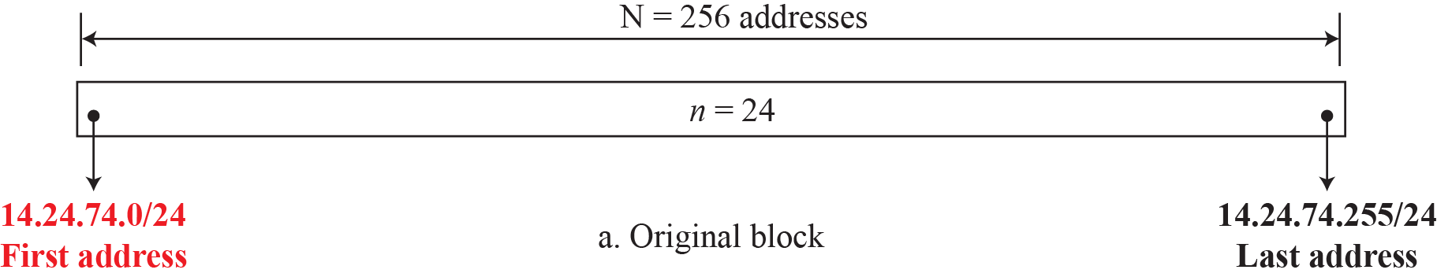
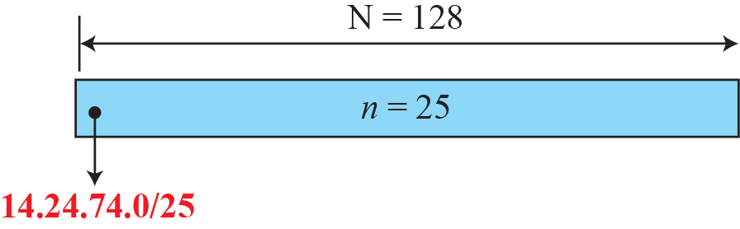
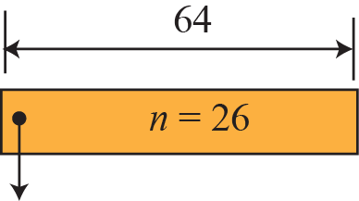
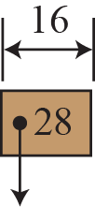
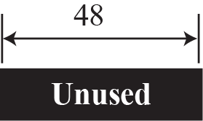



Figure 18.23: Solution to Example 4.5

Slide 10
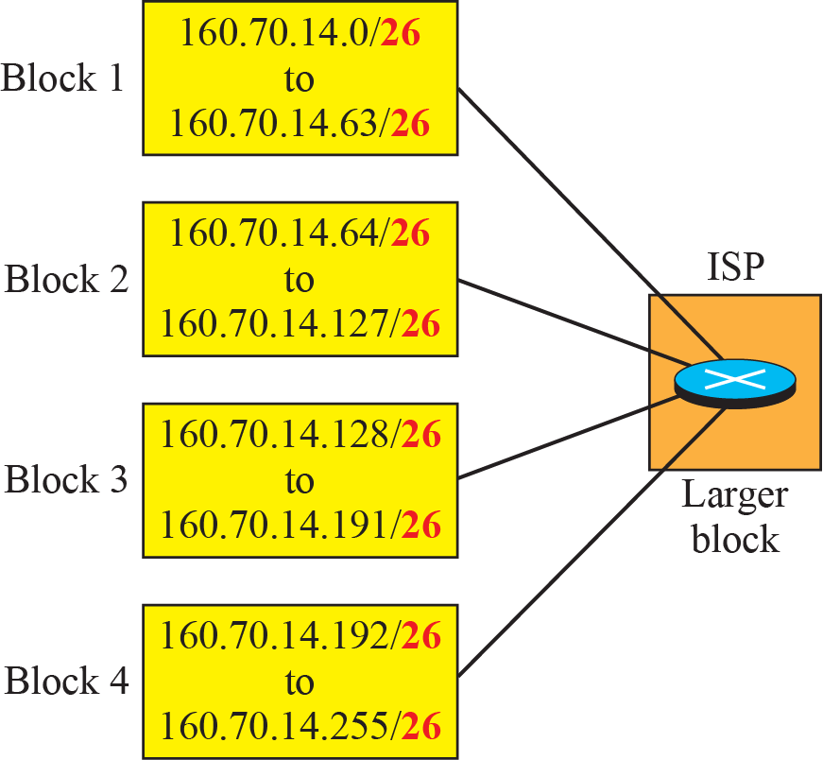
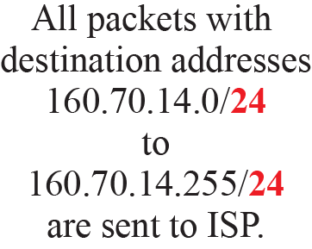
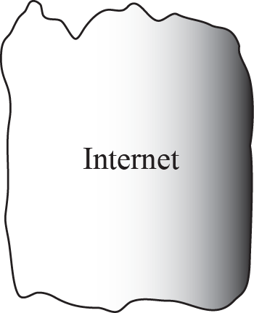
Figure 18.24: Example of address aggregation

Slide 11
Example 18.6
Figure 18.24 shows how four small blocks of addresses are assigned to four organizations by an ISP. The ISP combines these four blocks into one single block and advertises the larger block to the rest of the world. Any packet destined for this larger block should be sent to this ISP. It is the responsibility of the ISP to forward the packet to the appropriate organization. This is similar to routing we can find in a postal network. All packages coming from outside a country are sent first to the capital and then distributed to the corresponding destination.
18.11

Slide 12
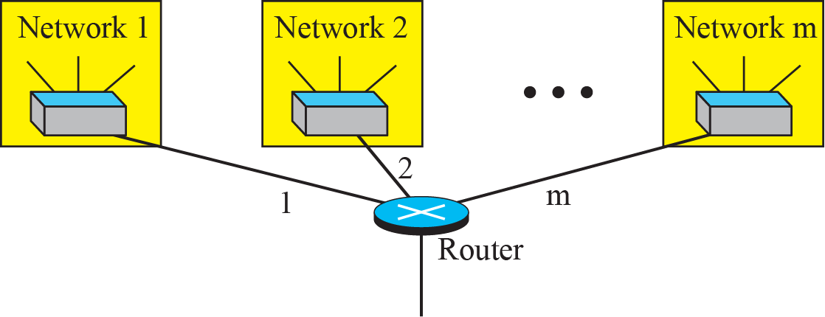
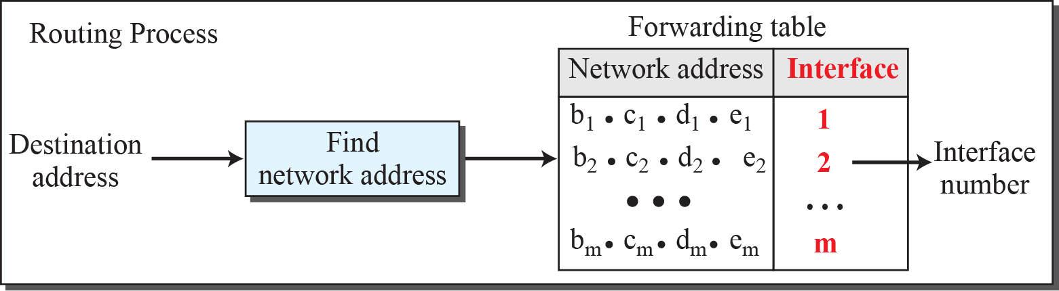
Figure 18.22: Network address

Slide 13
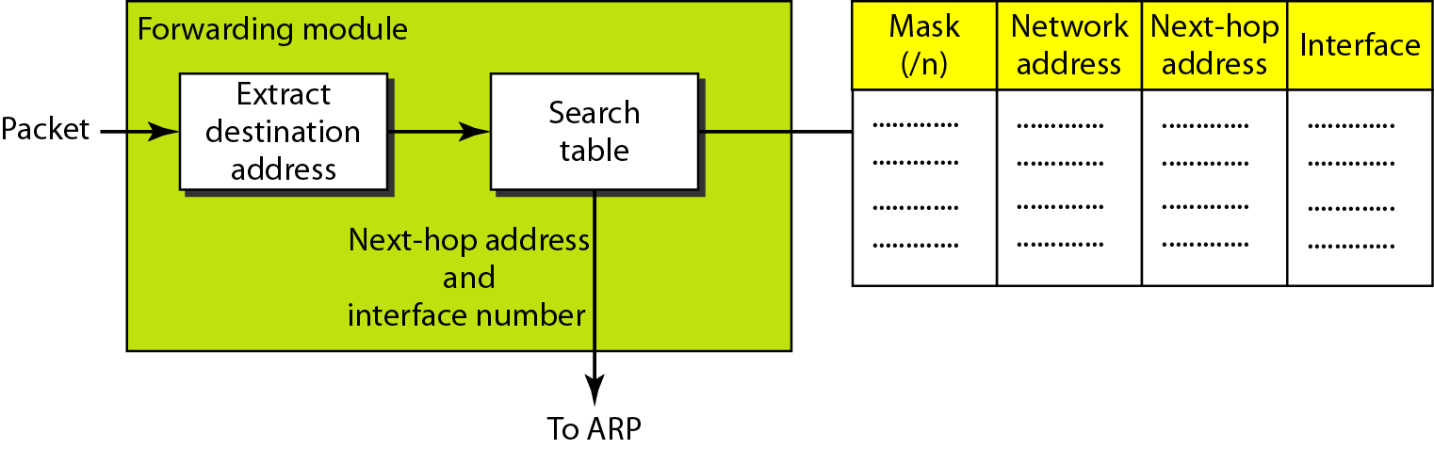
Figure 22.5 Simplified forwarding module in classless address
In classless addressing, we need at least four columns in a routing table.

Slide 14
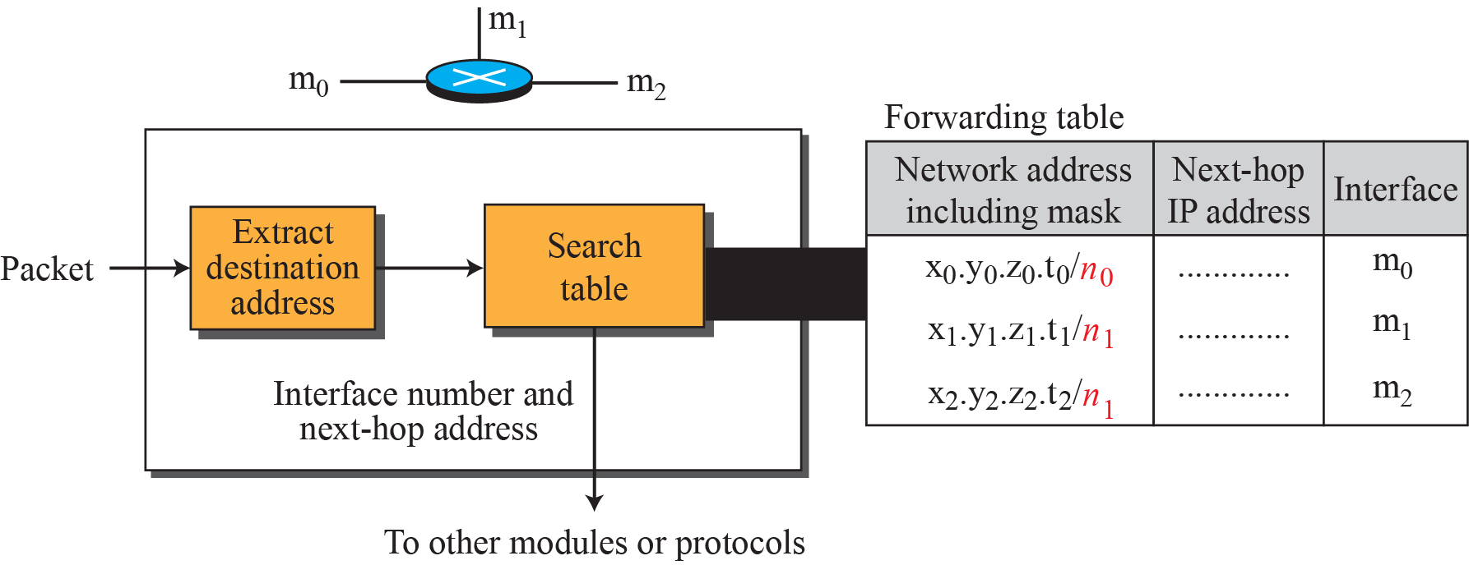
Figure 18.32: Simplified forwarding module in classless address

Slide 15

Note
In classless addressing, we need at least four columns in a routing table.

Slide 16
Subnetting – Ex 2
Organization Block 17.12.14.0/26
64 address
3 offices – to divide sub-blocks
1st office – 32 address
2nd office – 16 address
3rd office – 16 address

Slide 17
Subnetting – Ex 2
Organization Block 17.12.14.0/26
64 address
3 offices – to divide sub-blocks
1st office – 32 address
2nd office – 16 address
3rd office – 16 address
/n = 26, /n1 = 27 , /n2=28, /n3=28

Slide 18
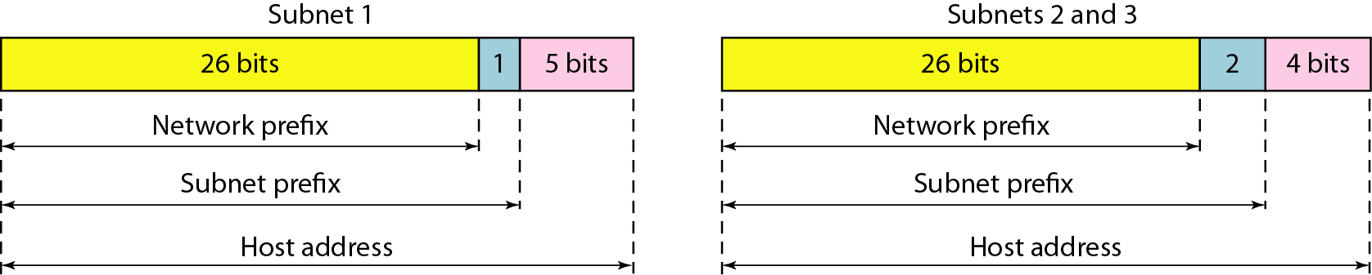
Figure 19.8 Three-level hierarchy in an IPv4 address

Slide 19
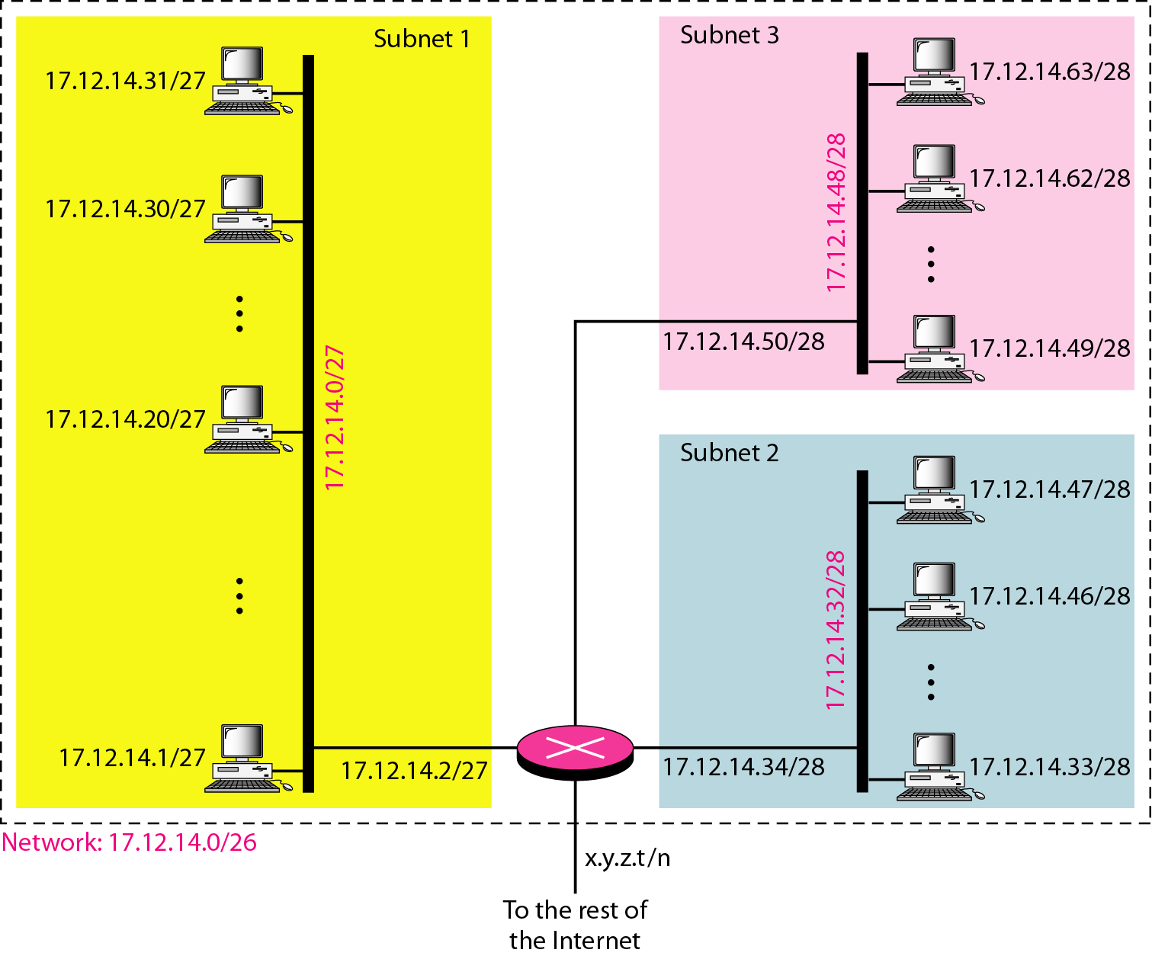
Figure 19.7 Configuration and addresses in a subnetted network

Slide 20
Subnetting – Ex 2
Don’t get confused with this Forouzan’s Example diagram shown in previous slide
Last address in that subnet is assigned to a system which ideally is wrong. (However total number of addresses in that subnet is correct)
Router is assigned one of the IPs in that subnet to one of it’s interface since it identifies to which subnet it has to forward the packet to.
Router will take decision by masking the Destination address based on prefix length to obtain Network portion and redirect to that subnet interface

